Slide 1
Ancient Civilizations and Their Sports
By Jalen Powell

Slide 2
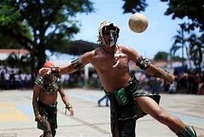
Background
Dating back to before the common era, sports and activities were used as a gift to the gods in order to gain the honor from the gods of their religion. Now don’t get it wrong, the Greeks and the Mayans did play sports for entertainment like how the world does right now. The only difference is the lethality of the sports and participation driven by honor.

Slide 3
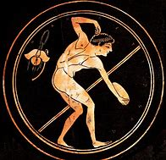
Early Civilizations
Not every civilization had their own version of sports activities but used different approaches to appease their gods. Methods such as rituals, sacrifices, or offerings. The smaller civilizations didn’t have the much of a population to make leisure time due to them sending a large portion to hunt and venture. The Roman Empire, ancient Greece, Mesopotamia, and the Mayans are some of the most known and established civilizations.

Slide 4
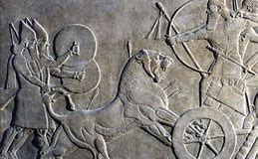
Mesopotamia
Mesopotamia being the oldest of the civilizations, they have laid the groundwork for the rest of them. People in ancient Mesopotamia exemplified using sports to gain honor from their gods. Common sports they would play were hunting, boxing, wrestling, and polo. Mesopotamians would hunt lions using beaters and dogs and once the lion was weakened the king would kill it with a spear and begin a religious ceremony. Boxing and wrestling were more or less the same but polo was played on the shoulders of other men instead of horses.

Slide 5
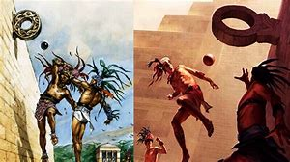
The Mayans
The Mayans were located on the western hemisphere while the others are in the middle east. Mesoamerica belonged to the indigenous societies before the 16th century conquest of the Spanish. The Mayans, along with sports, had games as well like the Ball Game where children and even women could participate. According to the Mayan legends, brutal rituals were involved in the game where the loser would have their head presented to the winning captain for it to be decapitated.

Slide 6
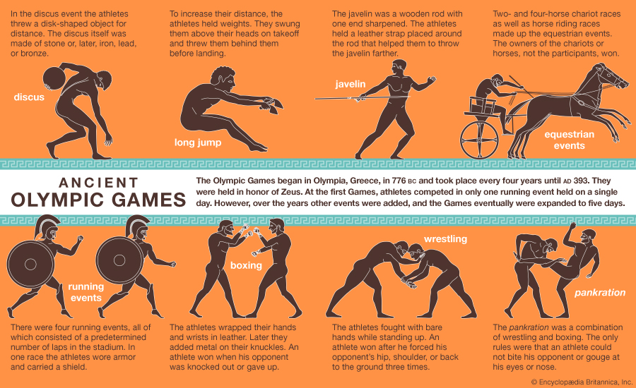
Greece and the Olympic Games
Ancient Greece began the Olympic games which is now a Global Event that happens every 4 years. The Greek’s theology was polytheistic so they believe in multiple gods and goddesses. The Olympic games are also named after the place where all their gods resign, Mount Olympus. The games were made to keep the participants in a constant state of practice due to it being catered for military and survival skills. Track & Field of today encapsulates the majority of events of the Olympics but the event is still on of its own.

Slide 7
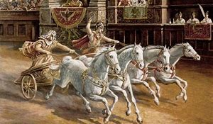
The Roman Sports
The Roman Empire was easily the largest empire from ancient times. The infamous emperors and the strategic combat genius led to their great success. Inside the great coliseum, many sports and exhibition matches took place. Gladiatorial combat, chariot racing, and combat against beast were all entertainment for the Emperor and the people of Rome. They also have many sports like boxing, wrestling, and something that resembled handball.

Slide 8
Civilizations and their Sports
Other than the Mayans, all the civilizations had more or less that same general sports. The religious factor that went into the sports showed the dedication the societies put forward to their beliefs. The relationship between civilizations and sports have multiple connections but religion seems to be more common. If not to a god or entity, then a ruler or emperor because most of the societies run off of a tier of power system or cast system. This leads to a lot of citizens believing that hard work and effort will honor who ever they plan on serving.

